Slide 1

ONLINE
BESPOKY
FITTING ROOM
PROVIDING A GOOD CUSTOMER EXPERIENCE
1

Slide 2
INTRODUCTION
THIS PROJECT AIMS TO SOLVE THE ISSUE OF HIGH RETURN RATES AND THE MISERY OF TRYING ON SEVERAL ARTICLES OF
CLOTHING IN A FITTING ROOM BY DEVELOPING AN
AUGMENTED- REALITY APP THAT ALLOWS CUSTOMERS TO
VISUALIZE HOW THINGS WILL FIT BEFORE PLACING AN ORDER.
2

Slide 3

CONTENT INDEX
INNOVIATIVE SOLUTION
GOALS AND
OBJECTIVES CHALLENGES
METHODOLOGY
ABOUT US & OUR TEAM
PROBLEM
STATEMENTS & SOME ANALYSIS
RESULTS
CONCLUSION AND FUTURE WORK
REFERENCES
3

Slide 4


ABOUT US & OUR TEAM
MOUSTAFA SAYED YOUSEF MOSTAFA AHMED AMR
ALAA IBRAHIM
RAWAN SAMIR FATMA RIDA
SUPERVISED BY:
DR. MARWA M.A. ELFATTAH
4

Slide 5

PROBLEM STATEMENTS
As Everything now is being digitally transformed, the value of e-business increases.
Within the past 10 years, online shopping has significantly increased.
LET'S SEE SOME IMPORTANT ANALYSIS
5

Slide 6
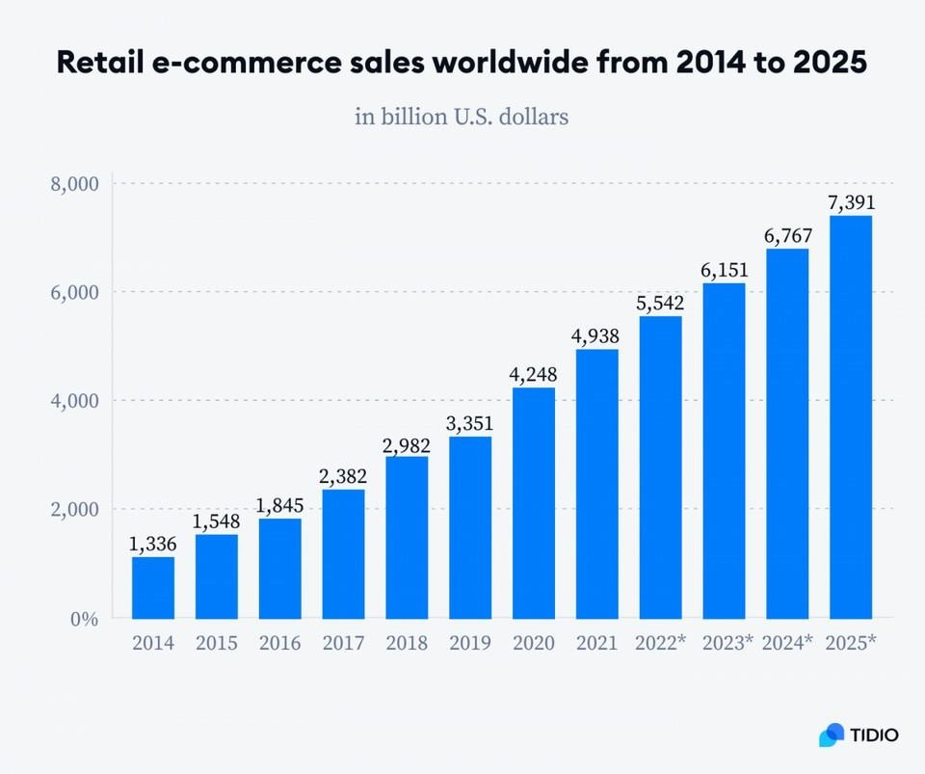
SOME ANALYSIS
This figure shows the significant growth of e-commerce from 2014 till 2025.
Reference: TIDIO Analysis

Slide 7
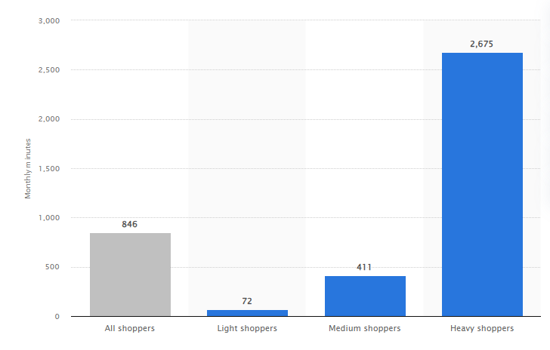
INNOVIATIVE SOLUTION
This figure shows how much customers spend time in shopping in the USA of December 2017.
Reference: www.statista.com

Slide 8

INNOVIATIVE SOLUTION
This project aims to solve the issue of high return rates and the misery of trying on several articles of clothing in a fitting room by developing an augmented reality & Computer Vision app that allows customers to visualize how things will fit before placing an order, provide a great customer experience, seek for the customers intimacy, and provide operational excellence.

Slide 9
GOALS AND OBJECTIVES
1 DEVELOPING A MOBILE APP
for shopping using Flutter.
ALLOWING CUSTOMERS TO
vi sualiz e pro ducts in 3 D and i n ter act with them to make better purchase decisions
usingAR & CV.
REDUCING COSTS AND SAVING TIME
increasing online sales and customer intimacy, leveraging AR technology, andreducing return rates for
retailers.

Slide 10


CHALLENGES AND IMPACT
Hardware limitations, lack of content, lack of regulations, compatibility testing, and physical safety risks.
Testing the app across different devices and operating systems, as compatibility issues can arise.
Impact on society includes saving money and time for customers, improving business marketing, but potentially reducing physical store sales.
Creating content that businesses can be extremely complicated and expensive.
Also, augmented reality developers have not created enough high-functioning use casesthat can be used by consumers daily.

Slide 11
METHODOLOGY
1 MATERIALS
2 METHODS

Slide 12








USED TO
DEVELOP OUR APP
Spyder Unity
clothes dataset)

Slide 13
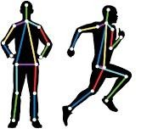



TECHNOLOGIES USED TO DEVELOP OUR APP
FLUTTER to create a virtual e-commerce app.
POSE DETECTOR model for T- shirts.
UNITY MARS for face & head

Slide 14
Project’s Lifecycle
The AR:
In this part we are going to see some visual results of the AR part of our fitting room.
The Computer Vision:
In this part we are going to see some visual results of CV part of the fitting room.
The Flutter App Results:
In this part we are going to see some visual results of the I n t er f ac e of our flutter online sho ppin g app.

Slide 15

1
AUGMENTED REALITY
RESULTS

Slide 16


Augmented Reality
We tried many techs like: Vuforia Engine, AR Core, and AR kit. And we actually created some simple applications using them.
After trying these techs and doing some researches about them, we found out that Vuforia is a real-world image & object tracing tech which is not our goal.
So, we went directly to AR core, and AR Kit digging deeper on them to find out the fitting, easier, most reliable tech to help us developing our app.

Slide 17
Augmented Reality
During our researches we found Unity Mars.
It’s a package supported by unity that exists as an additional layer taking advantage of the data from AR Foundation.
This package is developed by AR Foundation.
With Unity Mars, we could track the human body & face in unity.
But there is another problem appeared, Mars’s body detection is only supported by IOS which is not widely distributed between all the customers, which is not our goal, so we developed only the accessories fitting room using AR.

Slide 18
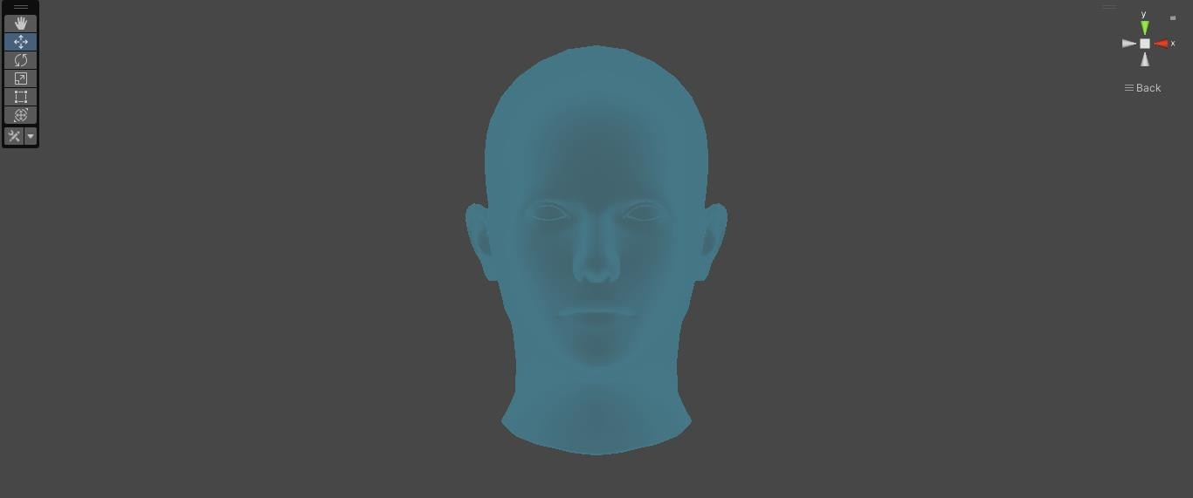
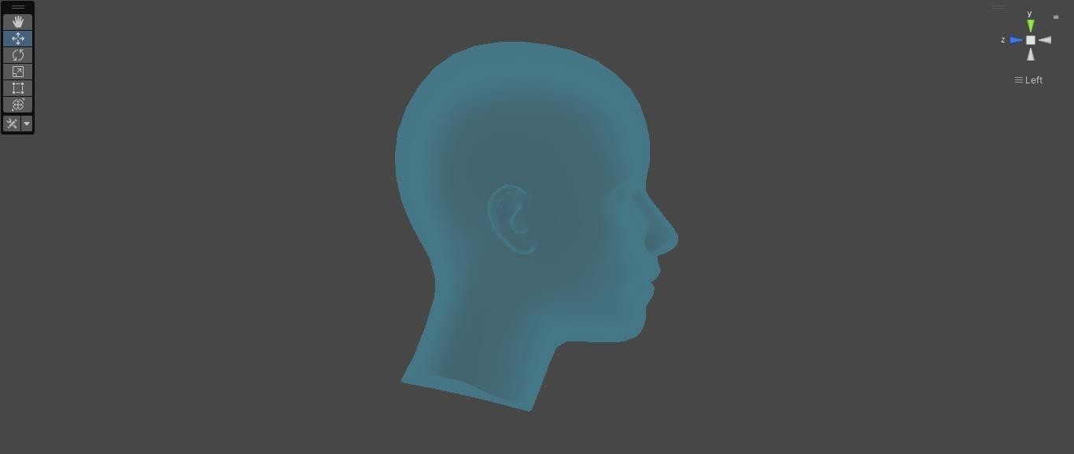
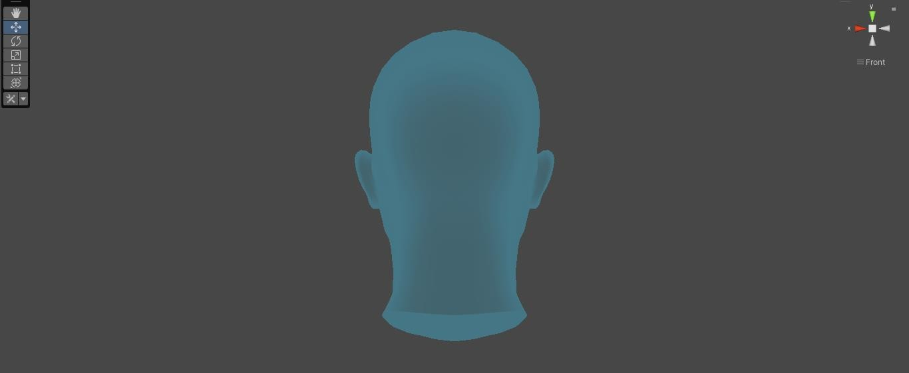
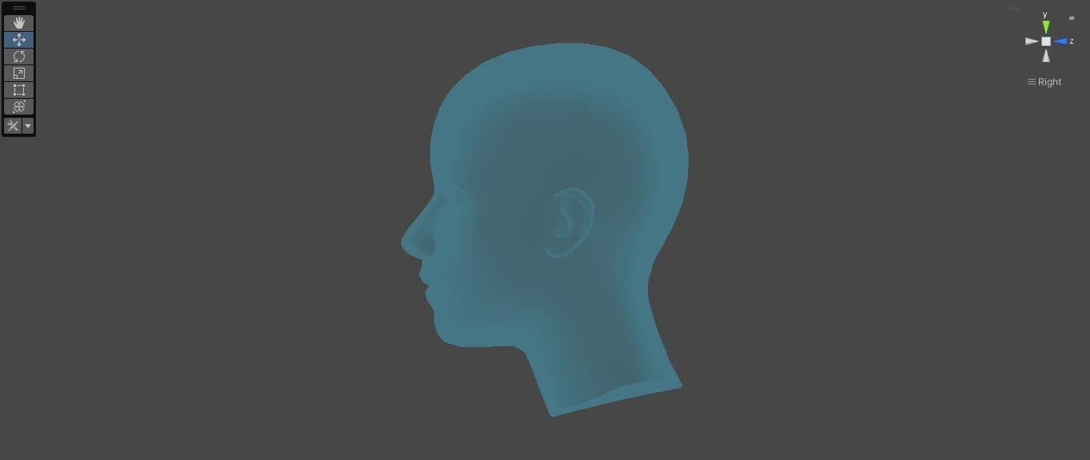
Augmented Reality
This is the avatar simulating the face which is used for tracking and adding digital object to be shown in the customer’s screen as a real-world object.

Slide 19

Augmented Reality
We used C# scripts to:
Switch objects' colors.
Clear controls (Allowing customers to take clear screenshot).

Slide 20

Augmented Reality
1. When the customer switches to the fitting room this page appears to him allowing him to choose the category.

Slide 21
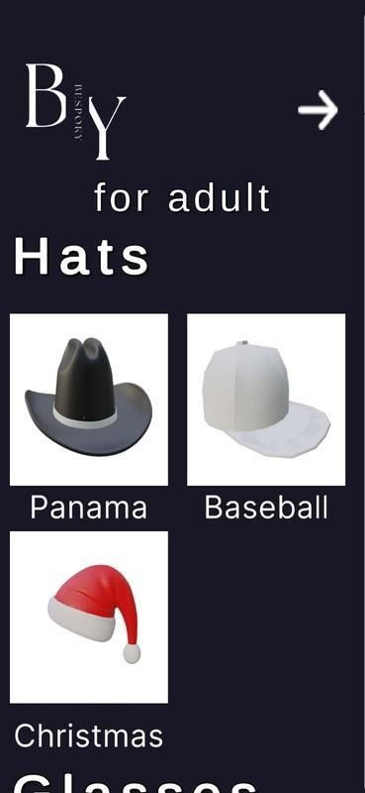
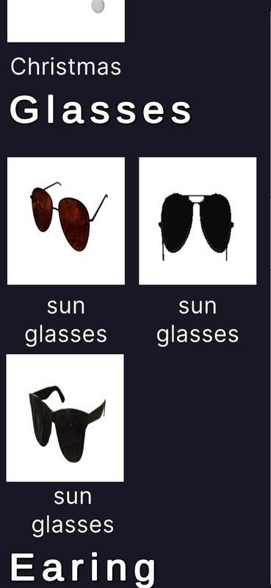
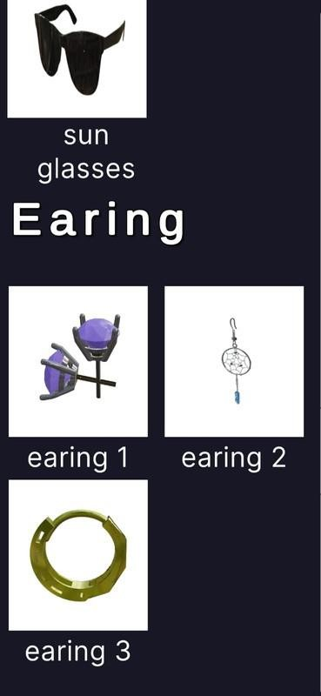
Augmented Reality
2. If he chooses the adult category, the adults' items will appear to him.

Slide 22
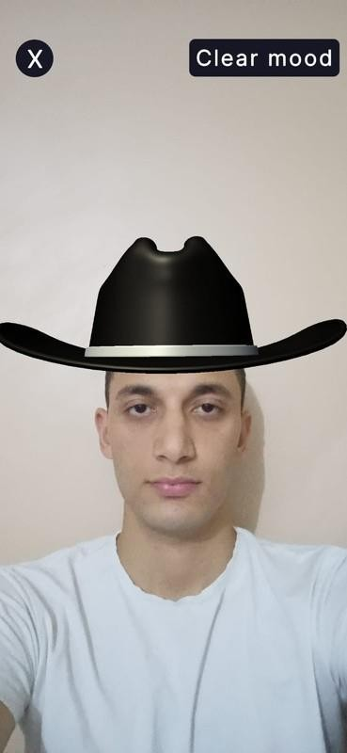
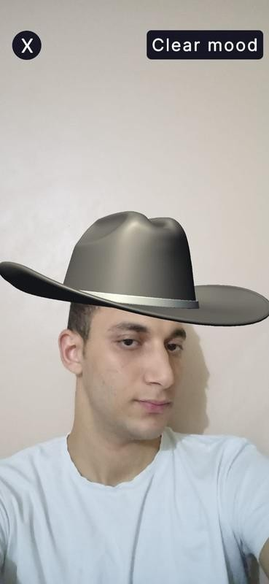
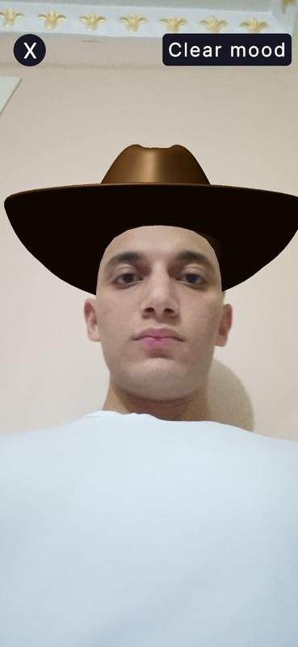
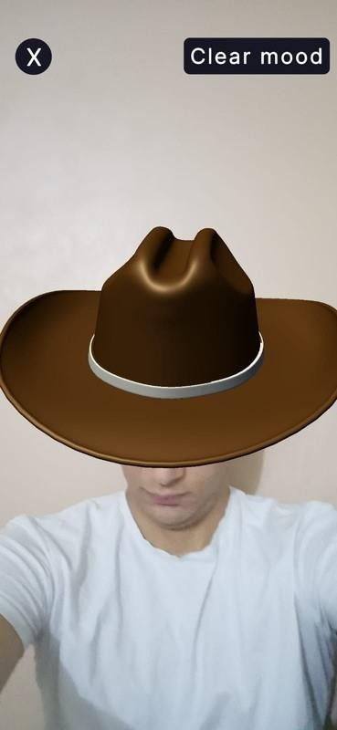
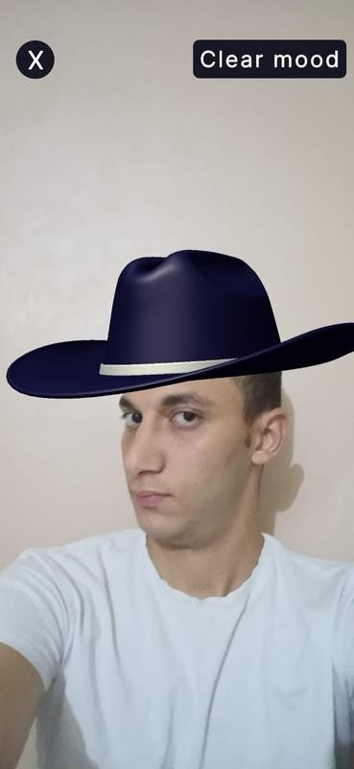

Augmented Reality
Visual examples of choosing the Panama hat:
The customer can
switch between
the available colors, see himself from different angles to make a good opinion about the item, and see if it fits him or not.

Slide 23
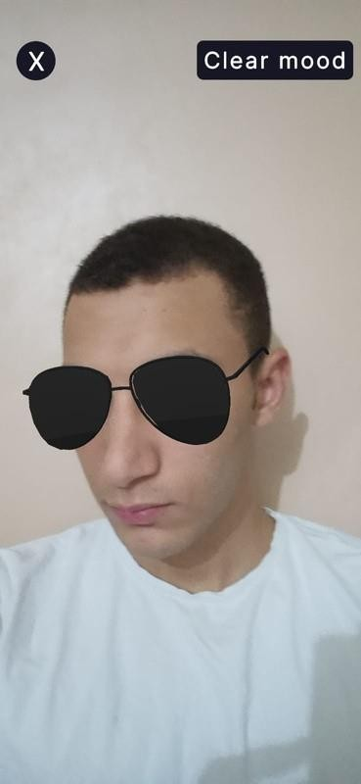
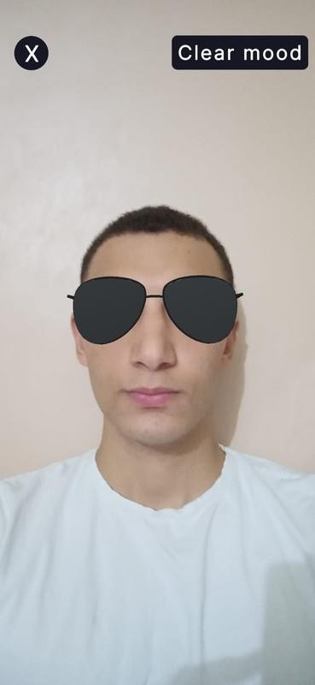

Augmented Reality
Visual examples of choosing the sunglasses:
The customer can see himself from different angles to make a good opinion about the glasses and if it fits him or not.

Slide 24

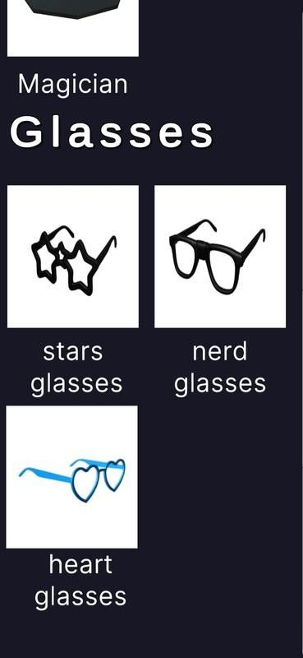
Augmented Reality
3. If he chooses the child category,
the children's items will appear to him.

Slide 25
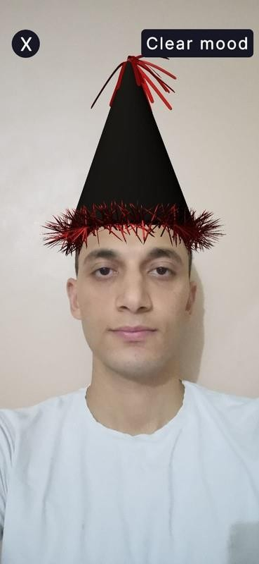
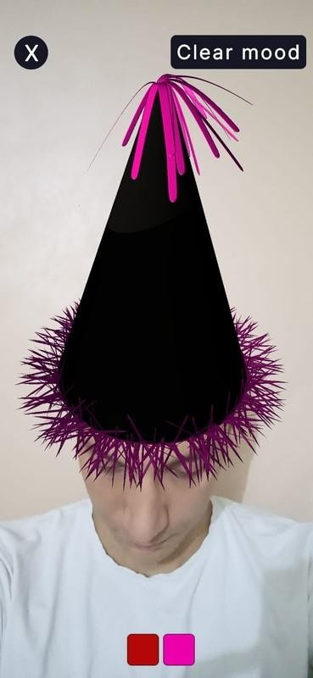
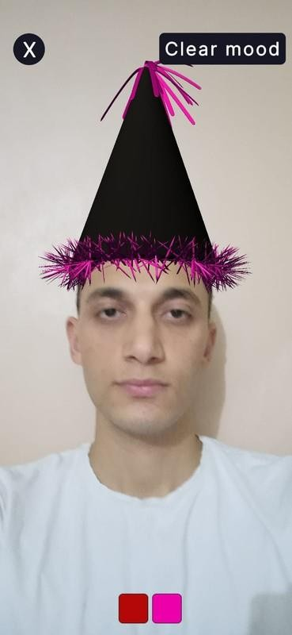

Augmented Reality
Visual examples of choosing a birthday hat:
The customer can switch between the available colors, see himself from different angles to make a good opinion about the item, and see if it fits him or not.

Slide 26
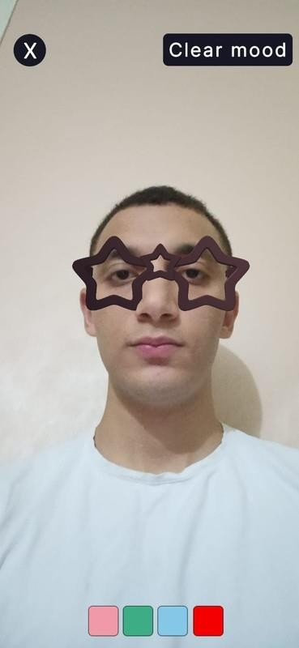
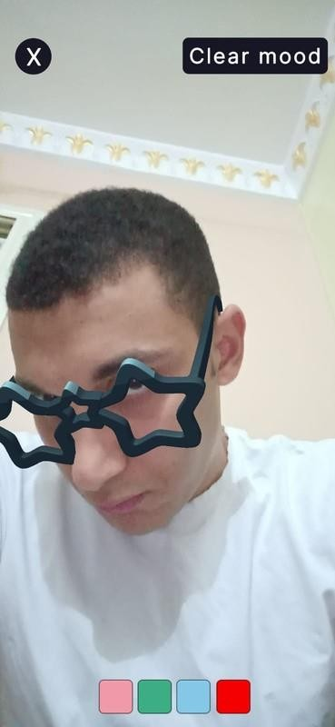

Augmented Reality
Visual examples of choosing the star glasses:
The customer can see himself from different angles to make a good opinion about the glasses and if it fits him or not.

Slide 27

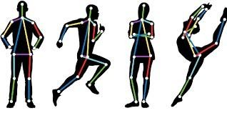
2
COMPUTER VISION
RESULTS

Slide 28
COMPUTER VISION RESULTS
Talking about problems of using computer vision:
First, we want to use GAN, but it needs a supercomputer which is unavailable for us.
Large dataset for shirts because we use image datasets, each image needs a different processing from the others and the main problem in the dataset is there is no dataset available, so we just collected images and made our preprocessing.

Slide 29
COMPUTER VISION RESULTS
Talking about solutions for these problems:
First, create an image processing class using python for handling the images and make some processing before using it in the model.
In image processing class we also handled sizes of shirts (small, medium, and xlarge) like (baby blue, mint green, and gray) shirts in order we see in the demo.
Second, create a model using cvzone that’s a library core use mediapipe and opencv libraries and we use the library to call pose detector module.
In pose detector module, we detect the poses on the human body and use it to overlay the shirts on the body.

Slide 30
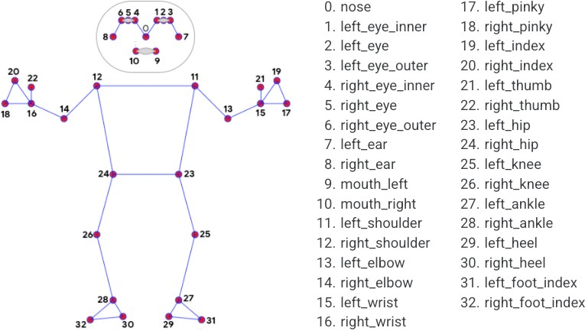
COMPUTER VISION RESULTS
As we see in the picture, each pose has its pose number that I use to overlay our shirts.
Finally, we overlay the shirts 2d over the body with accuracy 95% in shirts but still pantaloons have little accuracy.
31

Slide 31

COMPUTER VISION RESULTS

Slide 32
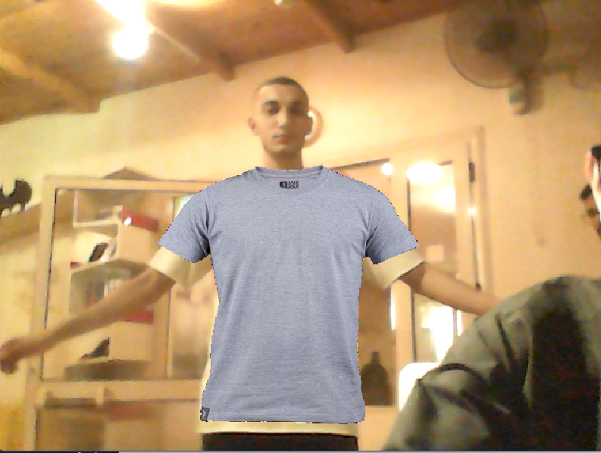
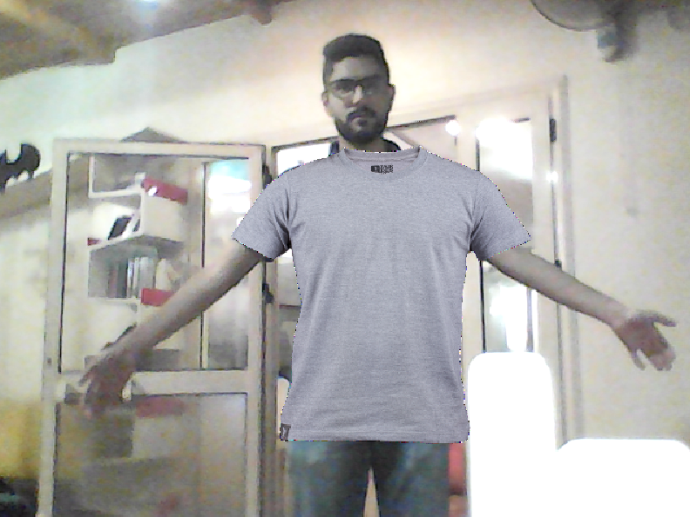
COMPUTER VISION RESULTS

Slide 33
CONCLUSION
Our application gives the customers the ability to see what they can buy in the real world.
Saving time and effort for the customer.
enhancing the market value & online shopping for the customers, giving them better service.

Slide 34



FUTURE WORK
Adding functions to let the admins add, edit, or remove items from the DB. Adding different payment methods.
Add a feedback page about the products and the customers’ experiences. Adding a recommendation system for the customers based on their last transaction,the
feedback, the customer’s activities, and his favorite items.
Adding a try it button on each item of the app for more accessibility. Replacing Computer vision with AR body detection for clothes.
Adding Different products categories.
Adding the recommended sizes panel for each item on the fitting room based on the
AR detection.
Dynamically adding the 3d objects on the fitting room reflecting to changes on the flutter app.
Adding Admin panel for the fitting room (Colors, fonts, product images).

Slide 35
THANK YOU
PLEASE FEEL FREE TO ASK ANY QUESTIONS. 😄

